Slide 1


DateTimePicker & MonthCalendar

Slide 2
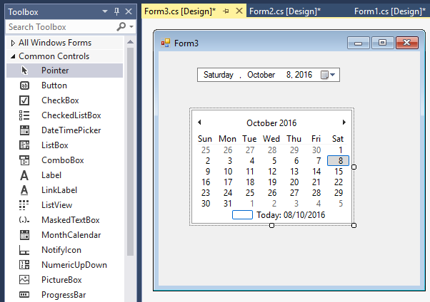
DateTimePicker & MonthCalendar

Slide 3
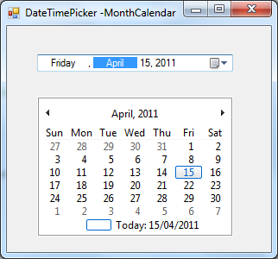
DateTimePicker & MonthCalendar
Các DatePicker control dùng để hiển thị ngày tháng năm
DateTimePicker
MonthCalendar

Slide 4
DateTimePicker & MonthCalendar
Các thuộc tính quan trọng:
Thuộc tính | Mô tả
Name | Tên control, thường bắt đầu dtp
Format | Cách hiển thị ngày tháng có sẵn
CustomFormat | Hiển thị ngày tháng theo cách NSD
Value | Giá trị ngày tháng trên control
dateTimePicker1.Format = DateTimePickerFormat.Custom;
dateTimePicker1.CustomFormat = “dd/MM/yyyy";

Slide 5
DateTimePicker & MonthCalendar
Format string | Description
d | The one- or two-digit day.
dd | The two-digit day. Single-digit day values are preceded by a 0.
ddd | The three-character day-of-week abbreviation.
dddd | The full day-of-week name.
h | The one- or two-digit hour in 12-hour format.
hh | The two-digit hour in 12-hour format. Single digit values are preceded by a 0.
H | The one- or two-digit hour in 24-hour format.

Slide 6
DateTimePicker & MonthCalendar
Format string | Description
HH | The two-digit hour in 24-hour format. Single digit values are preceded by a 0.
m | The one- or two-digit minute.
mm | The two-digit minute. Single digit values are preceded by a 0.
M | The one- or two-digit month number.
mm | The two-digit minute. Single digit values are preceded by a 0.
M | The one- or two-digit month number.
MM | The two-digit month number. Single digit values are preceded by a 0.
MMM | The three-character month abbreviation.

Slide 7
DateTimePicker & MonthCalendar
Format string | Description
MMMM | The full month name.
s | The one- or two-digit seconds.
ss | The two-digit seconds. Single digit values are preceded by a 0.
t | The one-letter A.M./P.M. abbreviation (A.M. is displayed as "A").
tt | The two-letter A.M./P.M. abbreviation (A.M. is displayed as "AM").
y | The one-digit year (2001 is displayed as "1").
yy | The last two digits of the year (2001 is displayed as "01").
yyyy | The full year (2001 is displayed as "2001").

Slide 8
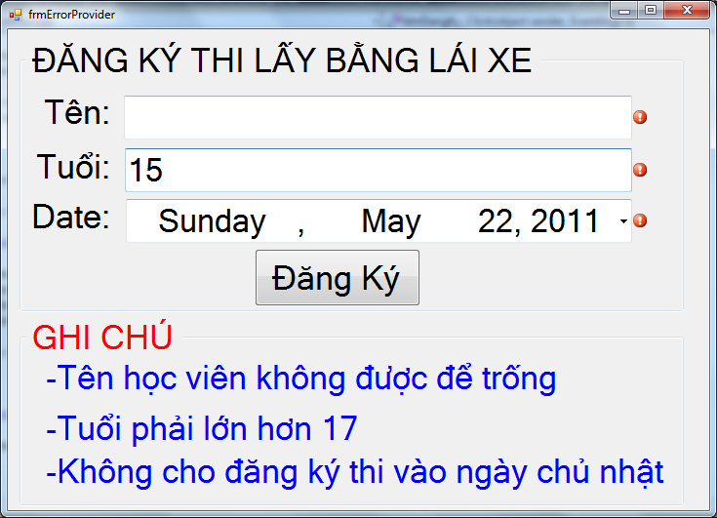
DateTimePicker & MonthCalendar

Slide 9


Hey! Coding is easy!
END

